Slide 1
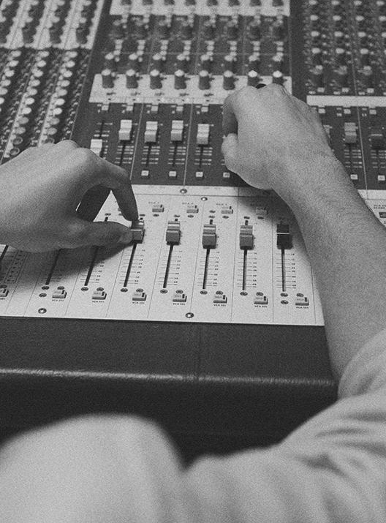
SHOOPA
MUSIC
MUSIC
MUSIC
Where the exploration begins…

Slide 2
Elevator Pitch
Are you an audiophile having difficulty finding songs
of that particular artist? Does a song stay on repeat in
your head after hearing it on the radio? Look no
further than Music Shoopa. A one-stop site to address
your music starvation needs. Search for your favorite
artists, click on the album you would like save to your
favorites list, and continuously add all the songs to
create your ultimate music playlist.

Slide 3




Table of Contents
Concept
Description
Motivation
User Story
Processes
Technologies
Challenges
Successes
Demo
Future Development
and Links

Slide 4
01
CONCEPT: Description, Motivation, and User Story
Description
We are the ultimate music searching companion for the music enthusiasts and head-boppers. Be able to search for your favorite artist and choose the album you would like to add to your favorites list. Swap out your favorite albums by using the addition or deletion feature. Make a favorites list reflecting what you are listening to today or reminiscing the days of your guilty pleasures.
Motivation of
Development
To create a singular database platform so that users have a better experience searching for a musical artist.
User Story
AS s music lover, I WANT to be able to create a page where the user can search for their favorite artist and get a list of albums SO THAT the user can add to a favorite list and be able to remove any album they have added.

Slide 5
Process: Technologies, Challengs, and Successes
Technologies Used
Javascript
CSS Bootstrap
Spotify Web API
Node.js and Express.js
SQL
MVC Paradigm
Heroku for deployment
Sequalize package
Moment.js npm package
Challenges
Integrating Spotify Web API.
Rendering the favorites list when an artist album is clicked.
Adding and Deleting albums so that it doesn’t interfere with the search history.
Successes
Creation of login/logout features where you do not have to restart the server.
Search results to display artist name with album cover.

Slide 6
DEMO:
Welcome to the
SHOOPA

Slide 7
FUTURE DEVELOPMENT
Q4 2023
Q3 2024
Q4 2024
2025-Beyond
Trax
Mobility
E-Commerce
Discovery
Ability to play sample tracks of songs on an artist’s album
Integration of mobile application
Accessibility to purchase singles or entire albums through the site
Social Media Integration
Search music by mood or activity
Notification of events nearby, album releases
Downloadable songs

Slide 8
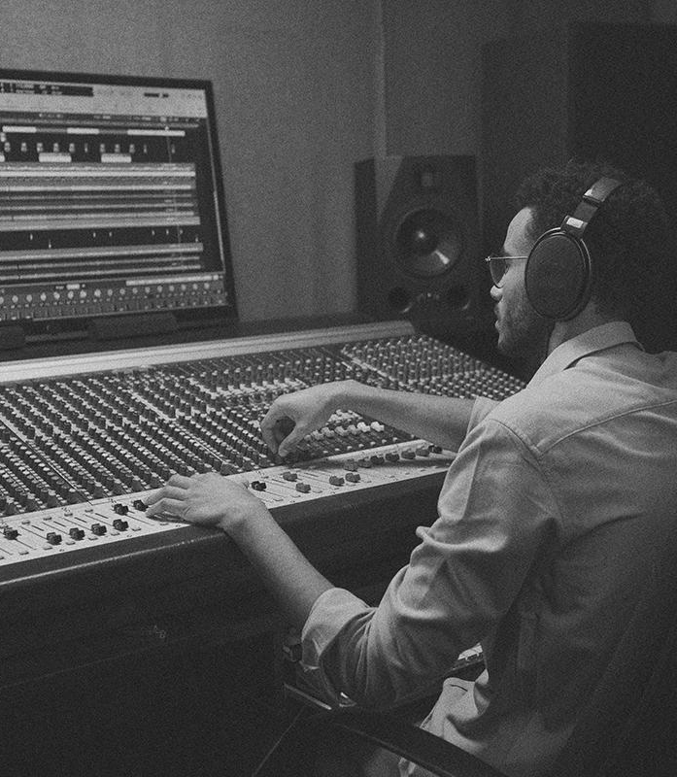
THANKS!
Does anyone have any questions?
info@musicshoopa.com | (999) 999-9999 musicshoopa.com
Contributors:
John Raab
Cullen Knott
Ruben Ruiz
Aaron Ko

Slide 9
LINKS
Github: https://jrsr5599.github.io/Project-2/

